Slide 1
TITLE
BLOCK CERTIFY
A SECURE VERIFICATION AND VALIDATION OF EDUCATIONAL CERTIFICATES USING BLOCKCHAIN TECHNOLOGY
Team Details :
1. Bandewar Sai Shashank (20EG105641)
2. Rolakanti Nikitha Reddy (20EG105656)
3. Kusumba Anvitha Rao (20EG105709)
Project Supervisor :
Mr.K.Sadanandam

Slide 2
Introduction
Educational documents or any certificates are meant to be a standing proof of the purpose they are created for. A degree or a diploma certificate is used to prove a person's abilities and educational qualifications. At the same time, it is very important for people to verify the authenticity of these documents. When fake documents circulate in the society, there is no distinguishable identification of such fake documents from legitimate ones. The verification mechanisms used today are very old, time consuming and for most part is not universally applicable. We propose an open-to-use application that can be used by Educational Institutions, Students and Verifiers (Employers) to generate NFT based certificates against existing and new educational documents that serve as a digital certificate that can be verified remotely and easily. This makes the whole process of the credit evaluation and document verification very simple and hassle-free.
In this project we are developing a cross-platform web application that is capable of generation and verification of educational document’s. This application aims to make the experience of certificate generation and verification very easy and fool - proof. Whenever an employer or an institution wants to verify a candidate’s credentials and scores in their degrees or certificate’s, they can simply use this application to verify the file given by the student , and find out whether it is legitimate.

Slide 3
Problem Statement
How can we create an efficient and secure blockchain-based document verification system that simplifies the verification process, provides a tamper-proof record of document history, and allows verifiers to confirm document authenticity quickly ?

Slide 4
Proposed Method
The proposed approach is to develop a cross-platform web application that runs on a server and performs the blockchain transactions pertaining to certificate generation on the Ethereum Blockchain. For demonstration purposes, The Ropsten Test Network has been utilized. The proposed system has some prerequisites that need to be fulfilled before the whole workflow can be assumed to be complete. Initially, the Certifying Institutions, or Authorities, like Schools and Colleges need to have their Ethereum Account Address (Public Wallet Address/ID) declared publicly on their websites for the verifiers to verify. This has to be specified on their respective website.

Slide 5
Proposed Method
The proposed system has the following advantages:
• Globally verifiable certificates/documents
• Accessed with a Transaction ID only
• Blockchain Transaction ensures data can not be modified once committed.
• Secure documents storage on Institution Servers.
• Close-to-zero time delay for verification of certificates.
• Effective Identification of Modified/Photoshopped documents.
• Easy transfer of documents from person to person in the form of NFTs

Slide 6
Experiment Environment
We will be using block chain technology and some machine learning algorithms
And then we will be - Creating NFT certificate module
- Verifying NFT certificate module

Slide 7
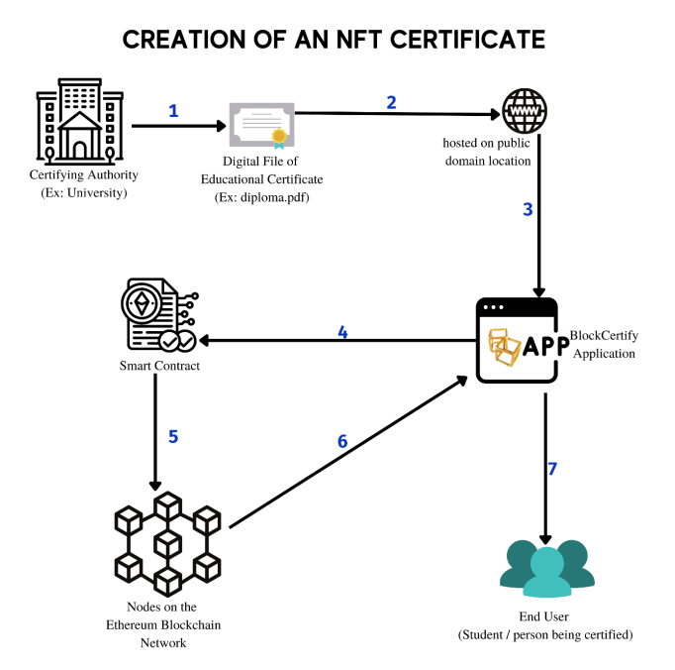
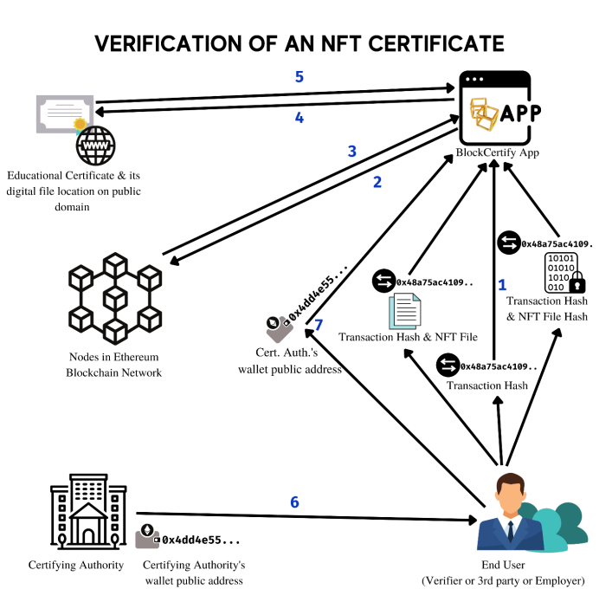
Experiment Screen shorts

Slide 8
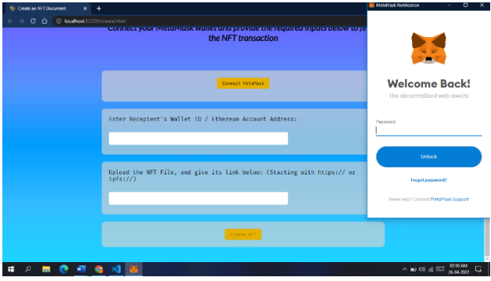
Experiment Results

Slide 9
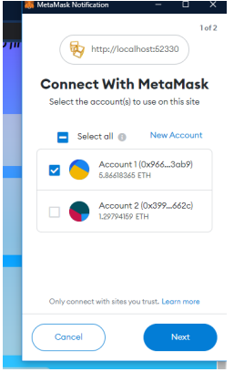
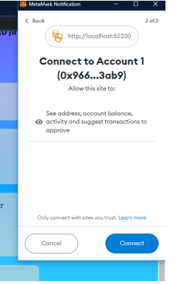

Slide 10
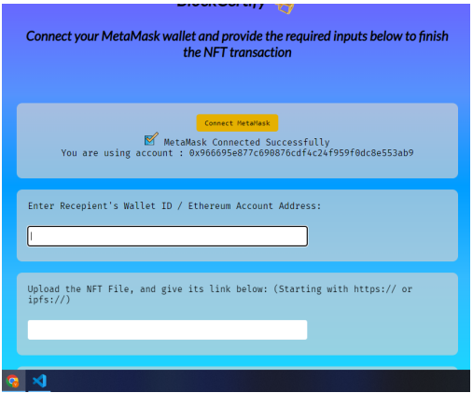

Slide 11
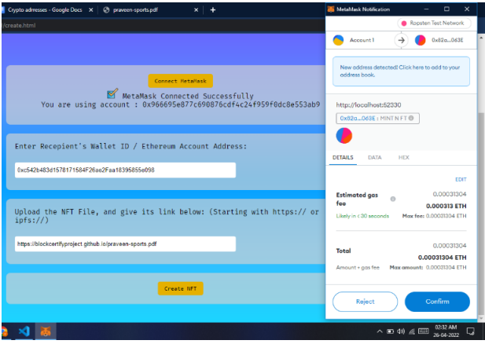

Slide 12
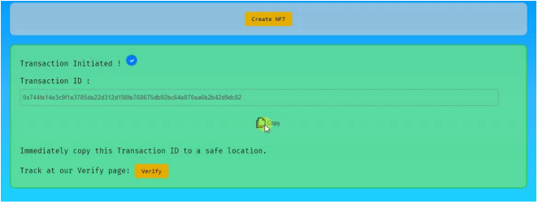

Slide 13
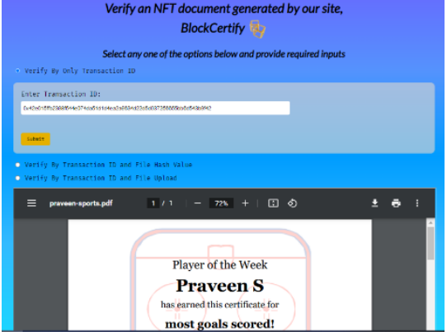

Slide 14
Finding
*Global Accessibility*: Blockchain technology is not tied to a specific region or country. It can be accessed and used globally, making it ideal for international verification and validation of certificates.
*Cost Efficiency*: Automating the verification and validation process through smart contracts on a blockchain can significantly reduce administrative and operational costs. There's less need for intermediaries, paperwork, and manual verification.
*User-Friendly Interfaces*: Creating easy-to-use interfaces and applications for certificate verification is essential to encourage adoption.

Slide 15
Justification
*Privacy and Security*: Blockchain allows for selective disclosure of information. Certificate owners can control who has access to their data, ensuring privacy and data security.
*Reduction in Fraud*: Blockchain-based verification can help reduce fraud in areas like academic qualifications, professional licenses, and more. Employers and other authorities can trust the validity of certificates.
*Smart Contracts*: Smart contracts on blockchain can automate the process of requesting, verifying, and issuing certificates. This increases efficiency and reduces human error.

